Slide 1

PRESENTATION ON MACHINE LEARNING PROJECT BY GROUP 3
PREDICT BANK PRODUCT UPTAKE
Prepared by:
WAKILU OLOYADE
MOSES YISA
BUSAYO OLANSEBE
TEMITAYO DARAMOLA
Submitted To:
10Alytics

Slide 2
EXECUTIVE SUMMARY
The role of banking in financial industry as well as in economic growth cannot be quantified. However, low product uptake affects the growth of the sector, hence the need for a model that robustly predicts uptake of products among existing and prospective customers. In this research, we compared the performances of four (4) machine learning models in predicting product uptake.
The classifiers considered were Logistic Regression, K Neighbors Classifier, Decision Tree Classifier and Random Forest Classifier.
The data used in the classification was from the 2011 Bank Marketing, which are available at:
[pdf] http://hdl.handle.net/1822/14838
[bib] http://www3.dsi.uminho.pt/pcortez/bib/2011-esm-1.txt

Slide 3
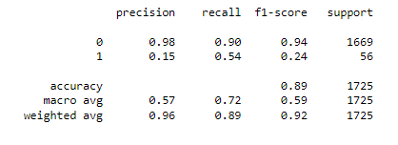
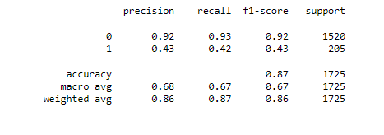
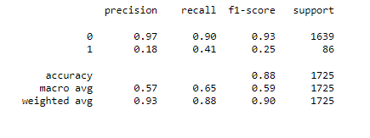
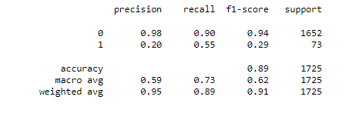
VISUALIZATION
Logistic Regression
Decision Tree Classifier
K Neighbors Classifier
Random Forest Classifier
VISUALIZATION

Slide 4
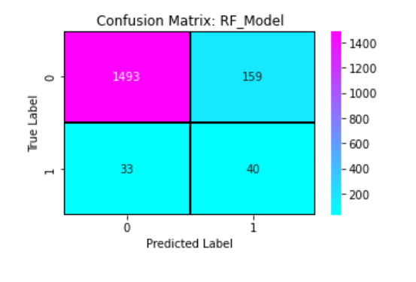
CONCLUSION
Confusion matrix for Random Forest
The best model to deploy for this production is Random Forest. Because it has highest percentage of recall with accuracy of 89%. Also, Confusion matrices were optimal for Random Forest, hence could be construed as the most robust model for predicting the Bank Product uptake.

Slide 5
THANK YOU.

